Slide 1
Class, Methods, Inheritance, Poly morphism
Sarower Ahmmed

Slide 2
Class
Class is blue print of object.
Object is instance of class.
How to create object?
Class name obj name= new Class name()
Constructor – invoke automatically when we create object
Why constructor invoke?-
To construct value in my variable(instance variable)

Slide 3
Why we need object?
To get /find objects inside the class
To get object properties-
State
Identification
Behavior

Slide 4
What happened if we don’t use constructor?
Our variable give/return default value when no value initialize
Int a ➔ Declaration
A=10➔ Initialization
Contructor placing user or programmer defined values in place of default values
If not initialize than what happen?
Int a default value of int =0
String a default value of String= null
Double a default value of double = 0.0

Slide 5
Type of constructor
Parameterize
Non-Parameterize

Slide 6
What do Constructors look like in Code?
Let’s find out. Here below Sum class has Sum() constructor
class Sum {
Sum() {
}
public static void main(String s[]) {
Sum s=new Sum();
}
}

Slide 7
Example of default constructor that displays the default values:
class Student {
int roll;
float marks;
String name;
void show() {
System.out.println("Roll: "+roll);
System.out.println("Marks: "+marks);
System.out.println("Name: "+name);
}
}
class TestDemo {
public static void main(String [] args) {
Student s1=new Student();
s1.show();
}
}
Output:
Roll: 0
Marks: 0.0
Name: null

Slide 8
How Constructor eliminates default values?
class Sum {
int a,b;
Sum() {
a=10;
b=20;
}
public static void main(String args[]) {
int c=a+b;
System.out.println("Sum: "+c);
}
}
Out put = 30

Slide 9
Parameterized constructor
If any constructor contain list of variable in its signature is known as parameterized constructor.
A parameterized constructor is one, which takes some parameters.
class Test {
int a, b;
Test(int n1, int n2) {
System.out.println("I am from Parameterized Constructor...");
This.a=n1; or a= n1;
This.b=n2; or b=n2;
System.out.println("Value of a = "+a);
System.out.println("Value of b = "+b);
}
}
class TestDemo1 {
public static void main(String args[]) {
Test t1=new Test(10, 20);
Test t2=new Test(30, 40);
}
}

Slide 10
Eclipse order for java project
Project- simple java/ Maven/ANT/Gridle project
Source folder-
Simple java project only one folder- src(source)
Maven project 4 folders
Write main methods or main code in –src/test/java
Package
Class
static variable and
instance variable
Constructor
Method/methods
Local variable
All your code
Print statement

Slide 11
Methods
It is a piece of code in java which represent behavior or action of object
How to write method?
Access modifier
Word static or nothing( if non-static)
Return type- void (no return)or nothing (return)
Method name
Parameter or argument – (inside parenthesis)
Method start with {
And method end at }

Slide 12
Example of main method
class TestDemo1 {
public static void main(String args[]) {
your code here
}
}

Slide 13
What minimum need to write a method
class TestDemo1 {
getSalary () {
your code here
}
}
Method name
Start point {
End point }
class TestDemo1 {
public getSalary () {
your code here
}
}
class TestDemo1 {
public void getSalary () {
your code here
}
}
class TestDemo1 {
public static int getSalary () {
your code here
}
}

Slide 14
Inheritance in java
Check words sheet Class note

Slide 15
Polymorphism in java
The word ‘polymorphism’ literally means ‘a state of having many shapes’ or ‘the capacity to take on different forms’.
Poly means many
Morphism means form or structure
Where to use different form/ polymorphism in java –
Methods
constructor

Slide 16
Polymorphism in Java has two types
Method overloading or Compile time polymorphism (static binding) and
method overriding or Runtime polymorphism (dynamic binding).
Overloading
One class,
Same method name
But parameter diff
Overriding
Two class
Inheritance>> extends
Same method name
But same parameter or diff parameter

Slide 17

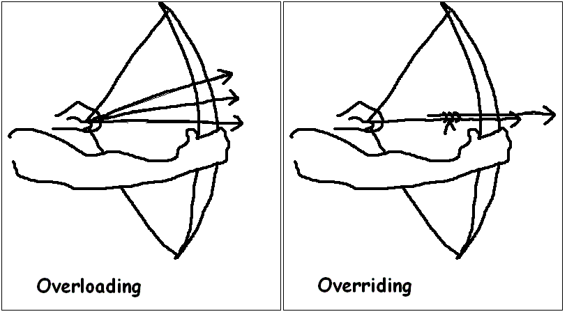


Overloading vs Overriding

Slide 18
Overloading or Compile time - criteria's
Overloading criteria or Compile time
Inside one class only
Same method or constructor name/signature
But only parameter change
Static and non static both method can use this
Only one Class, so no need inheritance of class

Slide 19
Example of method overloading polymorphism
class Calculation {
void sum(int a){
System.out.println(a);
}
void sum(int a,int b){
System.out.println(a+b);
}
void sum(int a,int b,int c){
System.out.println(a+b+c);
}
public static void main(String args[]) {
Calculation obj=new Calculation();
obj.sum(5); //5
obj.sum(20,20); //40
obj.sum(10,10,10); // 30
}
}
In such scenario, compiler is able to figure out the method call at compile-time that’s the reason it is known as compile time polymorphism.

Slide 20
Dynamic Polymorphism or runtime polymorphism or Overriding:
Criteria in java
Need two class (Child class extands parent class)
Use parent class same method name / signature in child class
But method parameter will be change
Static method no need overriding to use parent class method or overridding not possible
Constructor can not do overriding

Slide 21
How to do Overriding polymorphism
Suppose a sub class overrides a particular method of the super class.
Let’s say, in the program we create an object of the subclass and assign it to the super class reference.
Now, if we call the overridden method on the super class reference then the sub class version of the method will be called.

Slide 22
Overriding
}
}
class Vehicle{
public void move(){
System.out.println(“Vehicles can move!!”);
}
}
class MotorBike extends Vehicle{
public void move(){
System.out.println(“MotorBike can move and accelerate too!!”);
}
}
class TestDemo{
public static void main(String[] args){
Vehicle vh=new MotorBike();
vh.move();
}
}

Slide 23
Casting
Object create rule in java
Animal obj = new Animal();
Up casting - WebDriver driver = new ChromeDriver();
Down casting – Animal obj= new Dog();
Type casting - TakesScreenshot ts =(TakesScreenshot)driver;

Slide 24
Why java need static method?
No need to create object to call this static method – from one class to another class.
Static methods are class level, so JVM call them with or after the class
Performance faster than non static method as
No need object creation to call this method
No need to overridden polymorphism
Poly morphism
Overloading – static and non static method
Overriding –only non static , not possible for static method

Slide 25
Constructor Overloading
If same Name constructor exists multiple times
in the same class with
different number of parameters or
order of parameters or
type of parameters
is known as Constructor overloading.
Why need- constructor overloading
can be used to initialize same or different objects with different values.

Slide 26
Same constructor name but parameter different- help to re use same code / constructor
class Demo {
Demo () {
Your code here
}
Demo (datatype1 value1) {
Your code here
}
Demo (datatype1 value1, datatype2 value2) {
Your code here
}
Demo (datatype2 variable2) {
Your code here
}
Demo (datatype2 value2, datatype1 value1) {
Your code here
}
Your code here
}

Slide 27
Why overriding is not possible at constructor level.
The scope of constructor is within the class
But overriding process happen outside of the class
So that it is not possible to achieved
No overriding at constructor level.

Slide 28
THANKS ALL

